Slide 1

Apex Institute of Technology
Department of Computer Science & Engineering
Data Mining and Warehousing
(CSF-334)
Dr Neha Agarwal
E11231
Assistant Professor
CSE(AIT), CU
DISCOVER . LEARN . EMPOWER

Slide 2
Contents to be Covered
Association rule mining
Mining single-dimensional Boolean association rules from transactional databases

Slide 3
Is Apriori Fast Enough? — Performance Bottlenecks
The core of the Apriori algorithm:
Use frequent (k – 1)-itemsets to generate candidate frequent k-itemsets
Use database scan and pattern matching to collect counts for the candidate itemsets
The bottleneck of Apriori: candidate generation
Huge candidate sets:
10⁴ frequent 1-itemset will generate 10⁷ candidate 2-itemsets
To discover a frequent pattern of size 100, e.g., {a₁, a₂, …, a₁₀₀}, one needs to generate 2¹⁰⁰ ≈ 10³⁰ candidates.
Multiple scans of database:
Needs (n +1 ) scans, n is the length of the longest pattern

Slide 4
Mining Frequent Patterns Without Candidate Generation
Compress a large database into a compact, Frequent-Pattern tree (FP-tree) structure
highly condensed, but complete for frequent pattern mining
avoid costly database scans
Develop an efficient, FP-tree-based frequent pattern mining method
A divide-and-conquer methodology: decompose mining tasks into smaller ones
Avoid candidate generation: sub-database test only!

Slide 5
Construct FP-tree from a Transaction DB
TID Items bought (ordered) frequent items
100 {f, a, c, d, g, i, m, p} {f, c, a, m, p}
200 {a, b, c, f, l, m, o} {f, c, a, b, m}
300 {b, f, h, j, o} {f, b}
400 {b, c, k, s, p} {c, b, p}
500 {a, f, c, e, l, p, m, n} {f, c, a, m, p}
min_support = 0.5
{}
Steps:
Scan DB once, find frequent 1-itemset (single item pattern)
Order frequent items in frequency descending order
Scan DB again, construct FP-tree
Header Table
Item frequency head
f 4
c 4
a 3
b 3
m 3
p 3
f:4
c:1
c:3
b:1
b:1
a:3
p:1
m:2
b:1
p:2
m:1

Slide 6
Benefits of the FP-tree Structure
Completeness:
never breaks a long pattern of any transaction
preserves complete information for frequent pattern mining
Compactness
reduce irrelevant information—infrequent items are gone
frequency descending ordering: more frequent items are more likely to be shared
never be larger than the original database (if not count node-links and counts)

Slide 7
Mining Frequent Patterns Using FP-tree
General idea (divide-and-conquer)
Recursively grow frequent pattern path using the FP-tree
Method
For each item, construct its conditional pattern-base, and then its conditional FP-tree
Repeat the process on each newly created conditional FP-tree
Until the resulting FP-tree is empty, or it contains only one path (single path will generate all the combinations of its sub-paths, each of which is a frequent pattern)

Slide 8
Major Steps to Mine FP-tree
Construct conditional pattern base for each node in the FP-tree
Construct conditional FP-tree from each conditional pattern-base
Recursively mine conditional FP-trees and grow frequent patterns obtained so far
If the conditional FP-tree contains a single path, simply enumerate all the patterns

Slide 9
Step 1: From FP-tree to Conditional Pattern Base
Starting at the frequent header table in the FP-tree
Traverse the FP-tree by following the link of each frequent item
Accumulate all of transformed prefix paths of that item to form a conditional pattern base
Header Table
Item frequency head
f 4
c 4
a 3
b 3
m 3
p 3
{}
Conditional pattern bases
item cond. pattern base
c f:3
a fc:3
b fca:1, f:1, c:1
m fca:2, fcab:1
p fcam:2, cb:1
f:4
c:1
c:3
b:1
b:1
a:3
p:1
m:2
b:1
p:2
m:1

Slide 10
Properties of FP-tree for Conditional Pattern Base Construction
Node-link property
For any frequent item a_{i}, all the possible frequent patterns that contain a_{i} can be obtained by following a_{i}'s node-links, starting from a_{i}'s head in the FP-tree header
Prefix path property
To calculate the frequent patterns for a node a_{i} in a path P, only the prefix sub-path of a_{i} in P need to be accumulated, and its frequency count should carry the same count as node a_{i}.

Slide 11
Step 2: Construct Conditional FP-tree
For each pattern-base
Accumulate the count for each item in the base
Construct the FP-tree for the frequent items of the pattern base
{}
m-conditional pattern base:
fca:2, fcab:1
Header Table
Item frequency head
f 4
c 4
a 3
b 3
m 3
p 3
f:4
c:1
{}
All frequent patterns concerning m
m,
fm, cm, am,
fcm, fam, cam,
fcam
c:3
b:1
b:1

a:3
p:1
f:3

m:2
b:1
c:3
p:2
m:1
a:3
m-conditional FP-tree

Slide 12
Mining Frequent Patterns by Creating Conditional Pattern-Bases
Item
Conditional pattern-base
Conditional FP-tree
p
{(fcam:2), (cb:1)}
{(c:3)}|p
m
{(fca:2), (fcab:1)}
{(f:3, c:3, a:3)}|m
b
{(fca:1), (f:1), (c:1)}
Empty
a
{(fc:3)}
{(f:3, c:3)}|a
c
{(f:3)}
{(f:3)}|c
f
Empty
Empty

Slide 13
Step 3: Recursively mine the conditional FP-tree
{}
{}
Cond. pattern base of “am”: (fc:3)
f:3
c:3
f:3
am-conditional FP-tree
c:3
{}
Cond. pattern base of “cm”: (f:3)
a:3
f:3
m-conditional FP-tree
cm-conditional FP-tree
{}
Cond. pattern base of “cam”: (f:3)
f:3
cam-conditional FP-tree

Slide 14
Single FP-tree Path Generation
Suppose an FP-tree T has a single path P
The complete set of frequent pattern of T can be generated by enumeration of all the combinations of the sub-paths of P
{}
All frequent patterns concerning m
m,
fm, cm, am,
fcm, fam, cam,
fcam
f:3

c:3
a:3
m-conditional FP-tree

Slide 15
Principles of Frequent Pattern Growth
Pattern growth property
Let α be a frequent itemset in DB, B be α's conditional pattern base, and β be an itemset in B. Then α ∪ β is a frequent itemset in DB iff β is frequent in B.
“abcdef ” is a frequent pattern, if and only if
“abcde ” is a frequent pattern, and
“f ” is frequent in the set of transactions containing “abcde ”

Slide 16
Why Is Frequent Pattern Growth Fast?
Our performance study shows
FP-growth is an order of magnitude faster than Apriori, and is also faster than tree-projection
Reasoning
No candidate generation, no candidate test
Use compact data structure
Eliminate repeated database scan
Basic operation is counting and FP-tree building

Slide 17
FP-growth vs. Apriori: Scalability With the Support Threshold
Data set T25I20D10K

Slide 18
FP-growth vs. Tree-Projection: Scalability with Support Threshold
Data set T25I20D100K

Slide 19
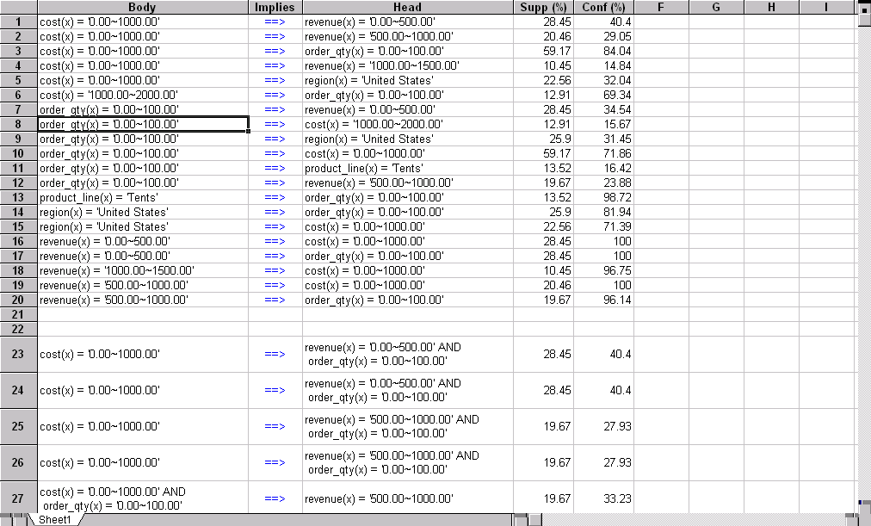
Presentation of Association Rules (Table Form )

Slide 20
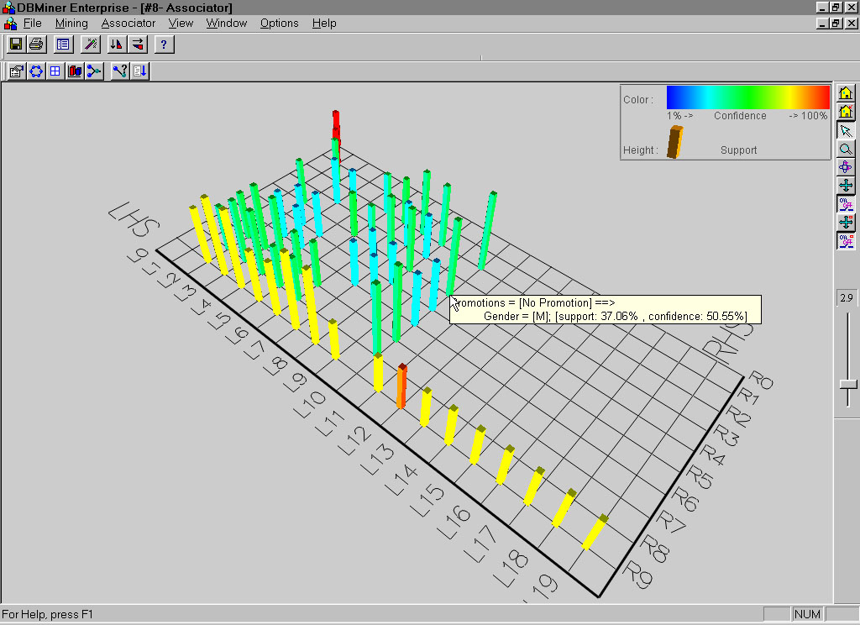
Visualization of Association Rule Using Plane Graph

Slide 21
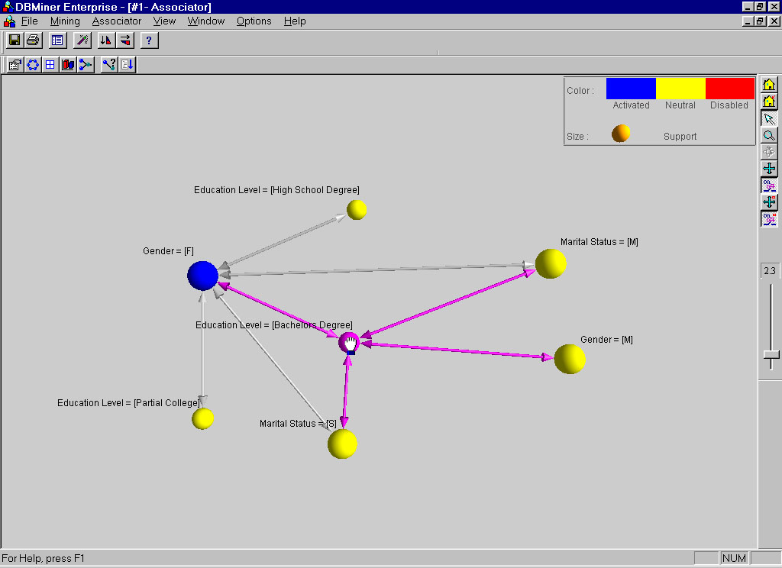
Visualization of Association Rule Using Rule Graph

Slide 22
Homework
Discuss the concept of fp growth.
How fp growth is better than apriori?

Slide 23
References
TEXT BOOKS
Introduction to Data Mining, Tan, Steinbach and Vipin Kumar, Pearson Education, 2016
REFERENCE BOOKS
Data Mining: Concepts and Techniques, Pei, Han and Kamber, Elsevier (2nd edition)
Journals
https://www.sciencedirect.com/science/article/pii/B9780323857086000084

Slide 24
Thank you
Please Send Your Queries on:
e-Mail: neha.e11231@cumail.in

